Slide 1
Propositional Equivalences M. Shahzad
Taken from: X. Zhang and Imdad ullah

Slide 2
Motivating example
Four machines A, B, C, D are connected on a network. It is feared that a computer virus may have infected the network. Your security team makes the following statements:
If D is infected, then so is C.
If C is infected, then so is A.
If D is clean, then B is clean but C is infected.
If A is infected, then either B is infected or C is clean.
Based on these statements, what can you conclude about status of the four machines?

Slide 3
Smullyan’s Island Puzzle
You meet two inhabitants of Smullyan’s Island (where each one is either a liar or a truth-teller).
A says, “Either B is lying or I am”
B says, “A is lying”
Who is telling the truth ?
3
Notes:
3

Slide 4
Practice
Introduce letters to stand for simple propositions, and write the following statements as compound propositions:
It’s sunny and cold.
The movie is not long, but it’s very interesting.

Slide 5
Many different English Expressions
In spoken language, there are many ways to express implication (if … then…)
It rains, therefore the ground is wet.
Wet ground follows rain.
As long as it rains, the ground is wet.
Rain is a sufficient condition for the ground to be wet.
When translating English to proposition forms
Rephrase sentence to “if …. Then…” without change its meaning

Slide 6
Many different English Expressions
“if p, then q” “p implies q”
“if p, q” “p only if q”
“p is sufficient for q” “a sufficient condition for q is p”
“q if p” “q whenever p”
“q when p” “q is necessary for p”
“a necessary condition for p is q” “q follows from p”
“q unless ¬p”
REFER to BOOK : Paragraph B4 Example 7

Slide 7
Outline
Evaluating order & truth table
Tautology, contradiction, equivalent
Logic operation laws
Applications: solving logic puzzles

Slide 8
Practice
Introduce letters to stand for simple propositions, and write the following statements as compound propositions:
The food is good or the service is excellent.
Neither the food is good nor the service is excellent.
He is good at math, or his friend is and helps him.

Slide 9
Sufficient and necessary condition
Examples:
Lighting is sufficient and necessary condition for thunder.
The knight will win if and only if the armor is strong.
The knight will win if the armor is strong.
The knight will win only if the armor is strong.

Slide 10
Biconditional connective
p if and only if q,
p is sufficient and necessary condition of q
p | q
T | T | T | T | T
T | F | F | T | F
F | T | T | F | F
F | F | T | T | T

Slide 11
Precedence Rules
Parenthesized subexpressions come first
Precedence hierarchy
Negation (˥) comes next
Multiplicative operations (∧) is done before additive operations (⋁,⊕)
Conditional-type operations ( ) are done last
In case of a tie, operations are evaluated in left-to-right order, except for conditional operator ( ) which is evaluated in right-to-left order
is evaluated as
is evaluated as

Slide 12
Outline
Simple Proposition
Logic operations & compound proposition
Unary operation: negation
Binary operation: conjuction (AND) , disjuction (OR), conditional ( ) , biconditional ( )
Evaluating order & truth table
Propositional equivalence
Propositional identities
Applications: solving logic puzzles

Slide 13
Solving problem using logic
Four machines A, B, C, D are connected on a network. It is feared that a computer virus may have infected the network. Your security team makes the following statements:
If D is infected, then so is C.
If C is infected, then so is A.
If D is clean, then B is clean but C is infected.
If A is infected, then either B is infected or C is clean.

Slide 14
Solving problem using logic
Four machines A, B, C, D are connected on a network. It is feared that a computer virus may have infected the network. Your security team makes the following statements:
If D is infected, then so is C.
If C is infected, then so is A.
If D is clean, then B is clean but C is infected.
If A is infected, then either B is infected or C is clean.
How many possibilities are there ?
A, B,C, D are all be clean
A, B,C are clean, D is infected,
A,B,D are clean, C is infected,
….
…
Is the first case possible ? The second ? …

Slide 15
a | b | c | d | S1 | S2 | S3 | S4
T | T | T | T | T | T | F | T
T | T | T | F | F | T | T | T
T | T | F | T | T | F | T | T
T | T | F | F | T | F | T | T
T | F | T | T | T | T | F | T
T | F | T | F | F | T | T | T
T | F | F | T | T | F | F | T
T | F | F | F | T | F | T | T
F | T | T | T | T | T | F | T
F | T | T | F | F | T | T | T
F | T | F | T | T | T | T | F
F | T | F | F | T | T | T | F
F | F | T | T | T | T | F | F
F | F | F | T | T | T | F | T
F | F | F | F | T | T | T | T

Slide 16
Consistency in System Specifications
Determine whether these system specifications are consistent:
“The diagnostic message is stored in the buffer or it is retransmitted.”
“The diagnostic message is not stored in the buffer.”
“If the diagnostic message is stored in the buffer, then it is retransmitted.”

Slide 17
Consistency in System Specifications
Determine whether these system specifications are consistent:
“The diagnostic message is stored in the buffer or it is retransmitted.”
“The diagnostic message is not stored in the buffer.”
“If the diagnostic message is stored in the buffer, then it is retransmitted.”
“The diagnostic message is not retransmitted”

Slide 18
Smullyan’s Island Puzzle
You meet three inhabitants of Smullyan’s Island (where each one is either a liar or a truth-teller).
A says, “Exactly one of us is telling the truth”.
B says, “We are all lying.”
C says, “The other two are lying.”
Now who is a liar and who is a truth-teller ?

Slide 19
How to solve such puzzle ?
The key: each inhabitant is either a liar or a truth-teller. A liar always lies; a truth-teller always tells the truth.
How many possibilities are there ?
A,B,C are all truth-tellers
A,B are truth-tellers, C is a liar
…
…
Is case 1 possible ? Case 2 ?

Slide 20
Express statements as propositional forms
A says: Exactly one of us is telling the truth
B says: we are all lying.
C says: the other two are lying.

Slide 21
Examine all possibilities
Exactly one of
us is telling the truth
All of us are lying
other two are lying.
a | b | c | A’s statement | B’s statement | C’s statement
T | T | T | F | F | F
T | T | F | F | F | F
T | F | T | F | F | F
T | F | F | T | F | F
F | T | T | F | F | F
F | T | F | T | F | F
F | F | T | T | F | T
F | F | F | F | T | F
Which scenarios, if any, are consistent, i.e., truth-tellers told
the truth, and liars lied ?
* A is truth-teller, B and C are liars.

Slide 22
Smullyan’s Island Puzzle
You meet two inhabitants of Smullyan’s Island (where each one is either a liar or a truth-teller).
A says, “Either B is lying or I am”
B says, “A is lying”
Who is telling the truth ?

Slide 23
Outline
Simple Proposition
Logic operations & compound proposition
Unary operation: negation
Binary operation: conjuction (AND) , disjuction (OR), conditional ( ) , biconditional ( )
Evaluating order & truth table
Propositional equivalence
Propositional identities
Applications: solving logic puzzles

Slide 24
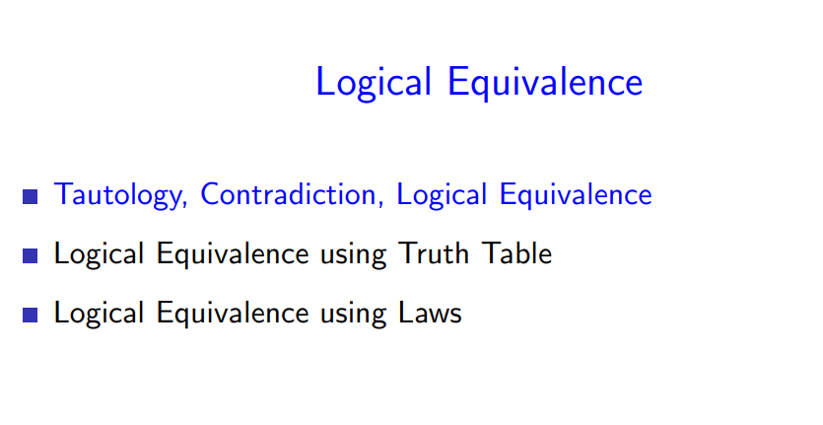

Slide 25
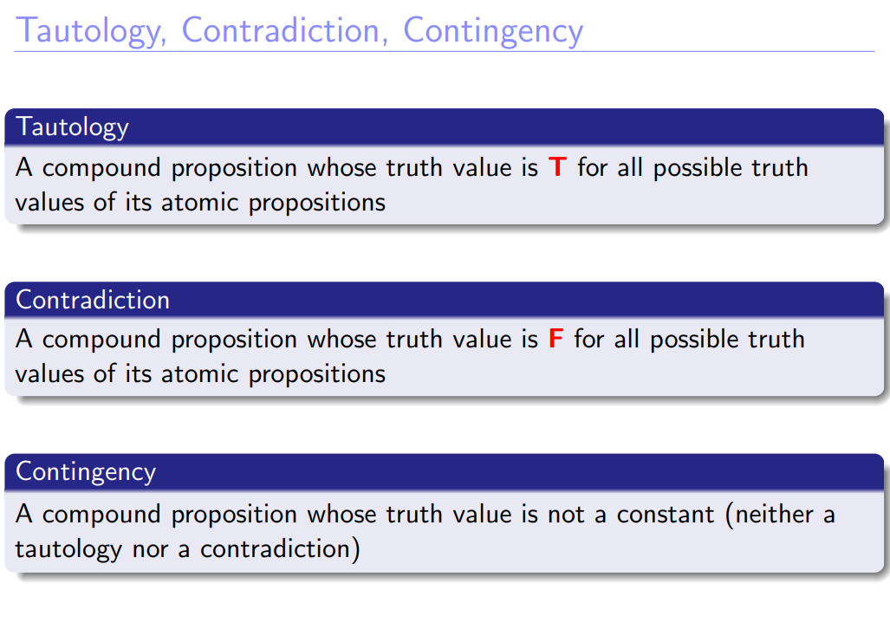

Slide 26
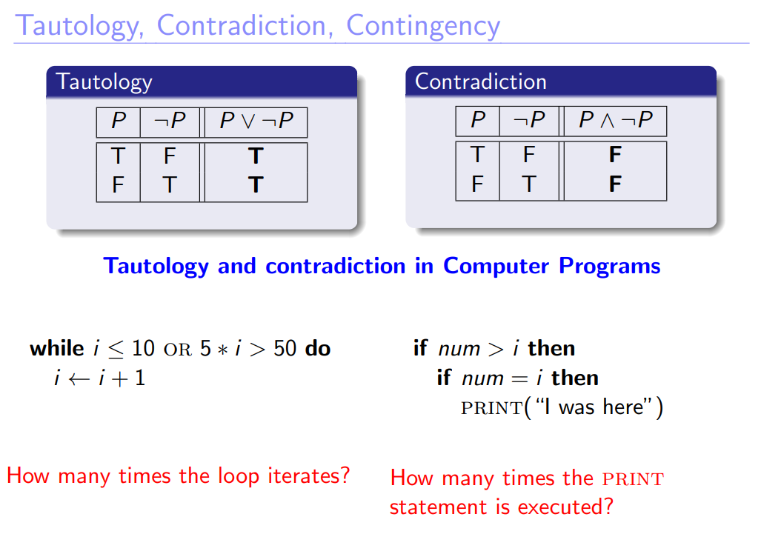

Slide 27
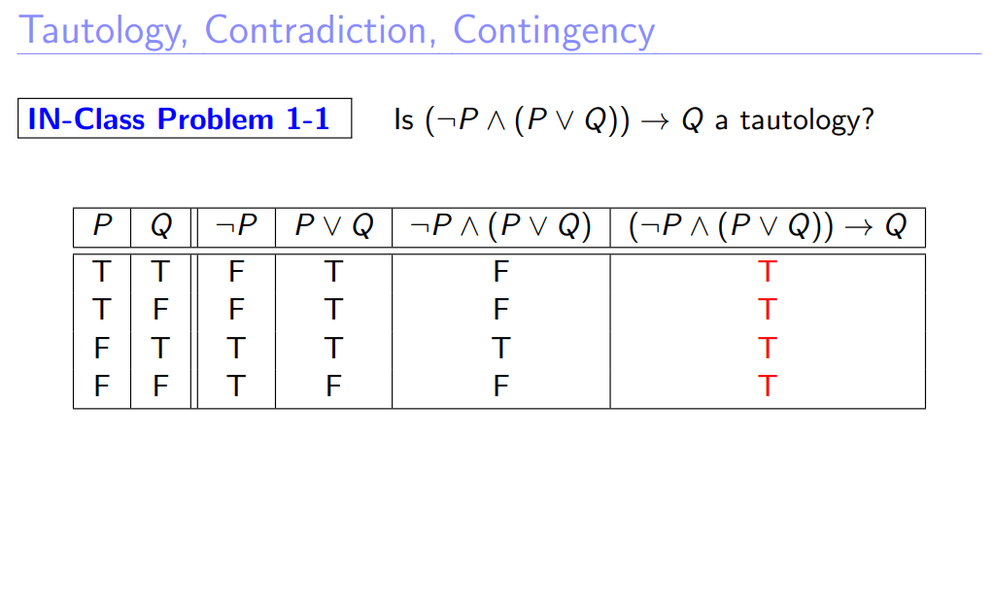

Slide 28
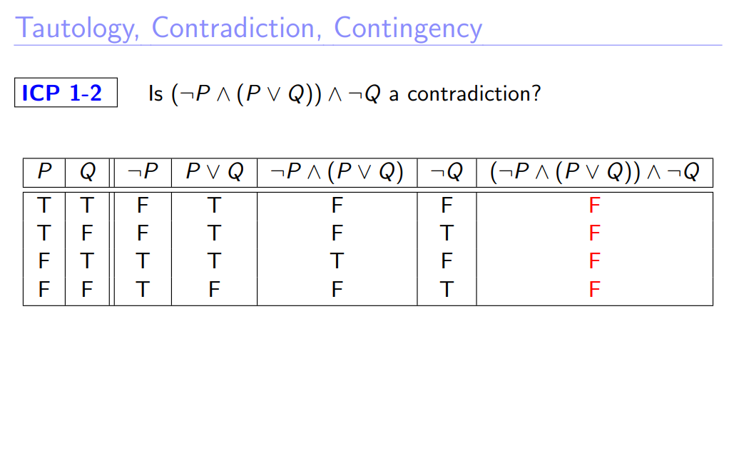

Slide 29
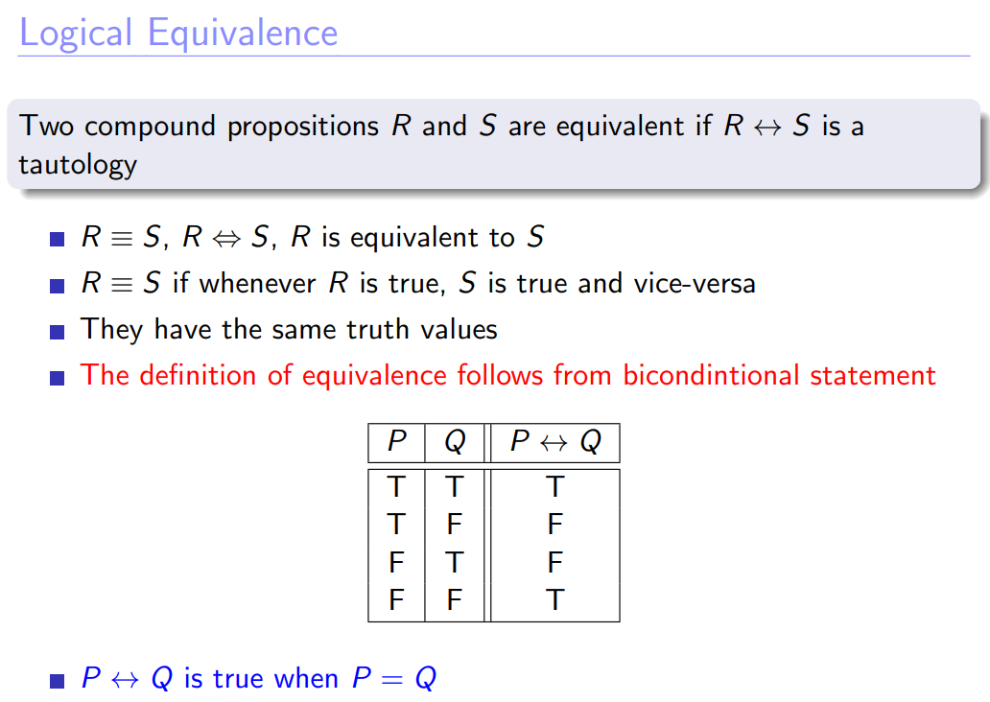

Slide 30
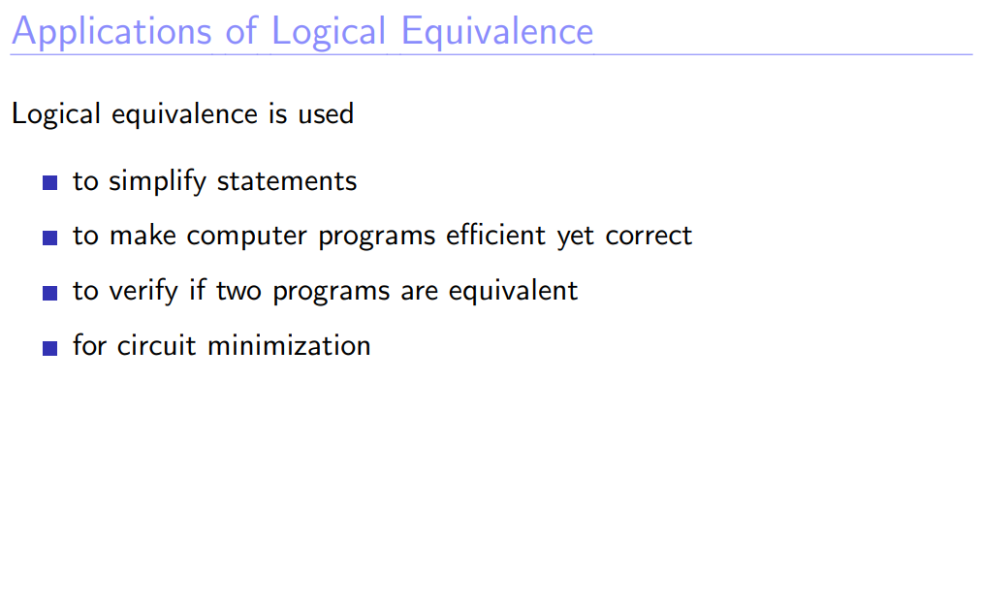

Slide 31
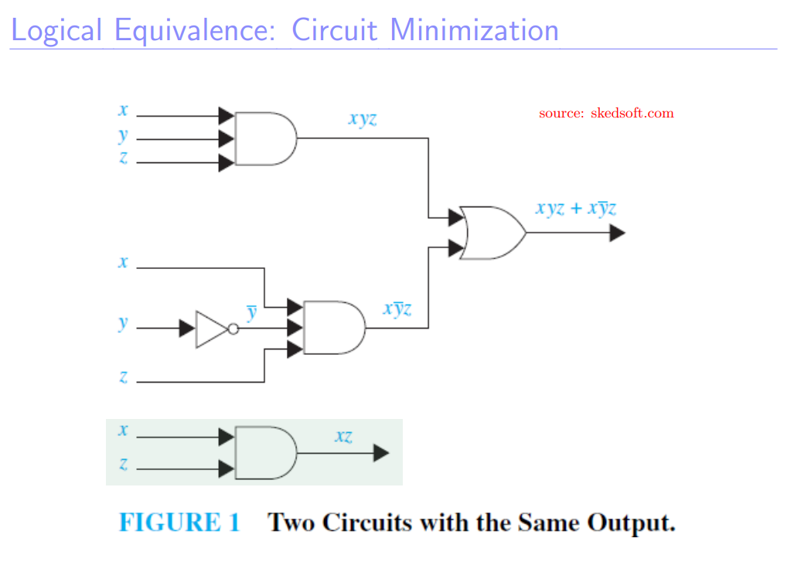

Slide 32
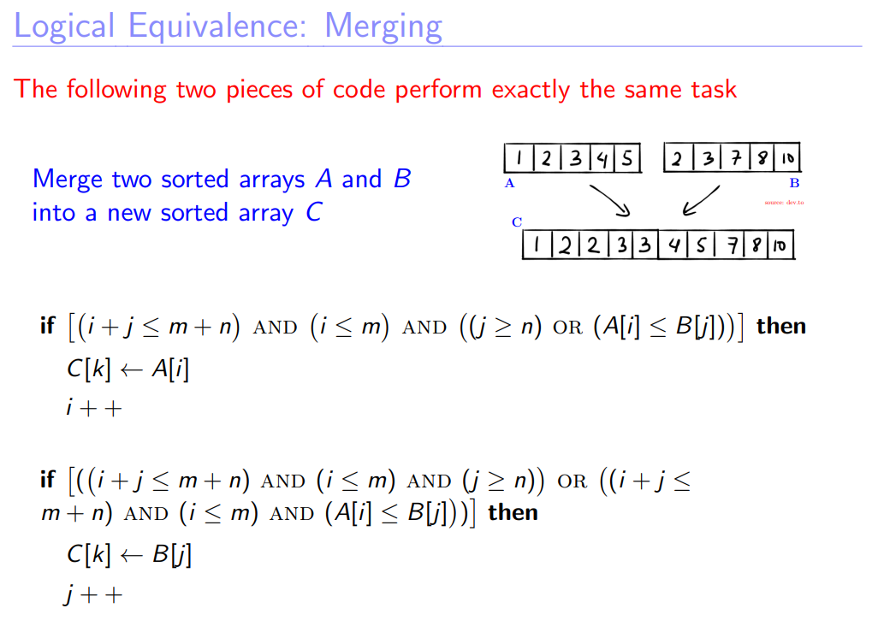

Slide 33
Logical equivalence
Two propositional forms are logically equivalent, if they have same truth value under all conditions
We represent logical equivalence using
To prove or disprove logical equivalency
Draw and Compare true tables of the two forms

Slide 34
Logic Identities (1)
Commutative
1.
2.
Associative
1.
2.

Slide 35
Logic Identities (2)
DeMorgan’s laws
1.
2.

Slide 36
Logic Identities (3)
Distributive
1.
2.

Slide 37
Logic Identities (4)
Double negative
Contrapositive
Implication Law

Slide 38
Simplify propositional forms
Simplify the following propositional forms, i.e., find a simpler equivalent form
Human beings understand the simplified form much better…
Put negation closer to the simple proposition
Get rid of double negation
Key: apply logical equivalence rules such as DeMorgan Law, implication law, double negation …

Slide 39
Simplify propositional forms (2)
Key: apply logical equivalence rules such as DeMorgan Law, implication law, double negation …
We don’t know how to directly negate a “if … then” form
First apply implication law, then use DeMorgan law:

Slide 40
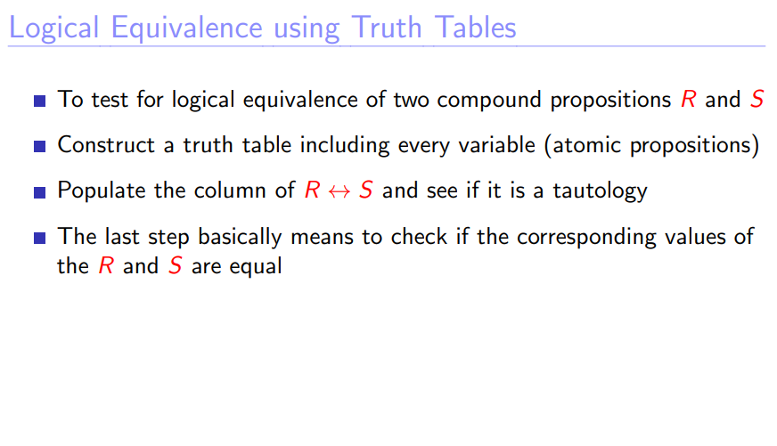

Slide 41
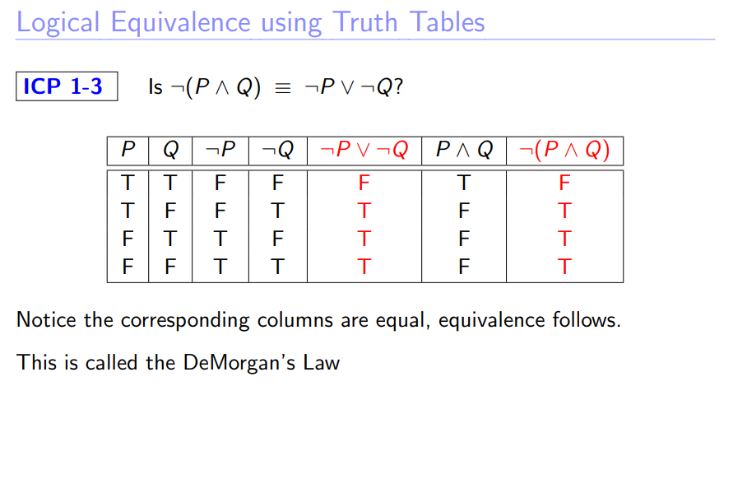

Slide 42
